Slide 1

South Carolina
Presentation by
Yuri and Ali

Slide 2
Contents
Capital City
Famous places and landmarks?
Symbols of the State
Famous Peoples
Facts
2

Slide 3
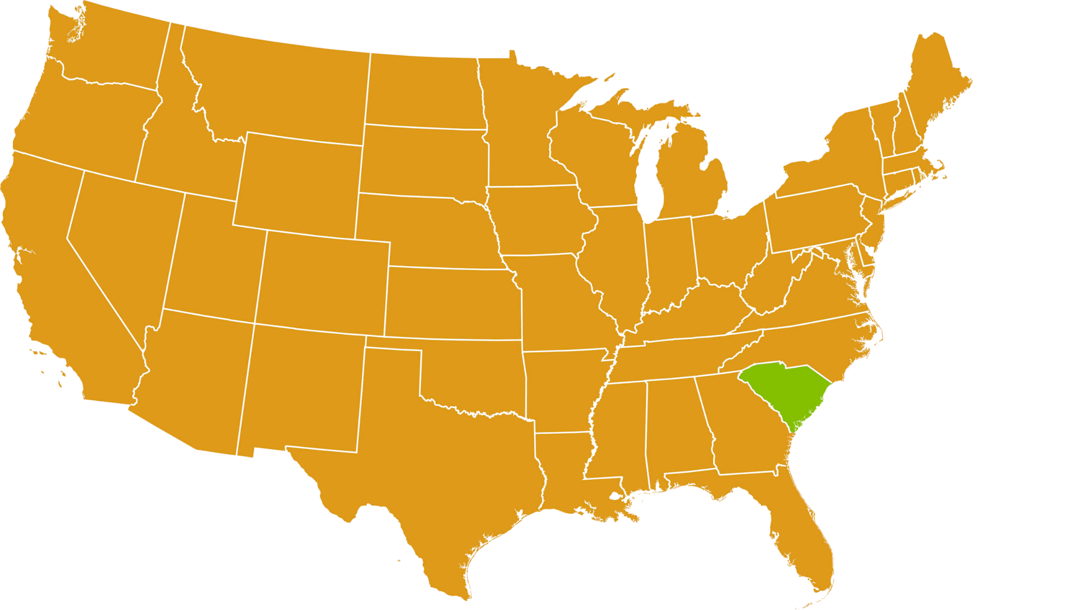
State & Capital City
3
3

Slide 4
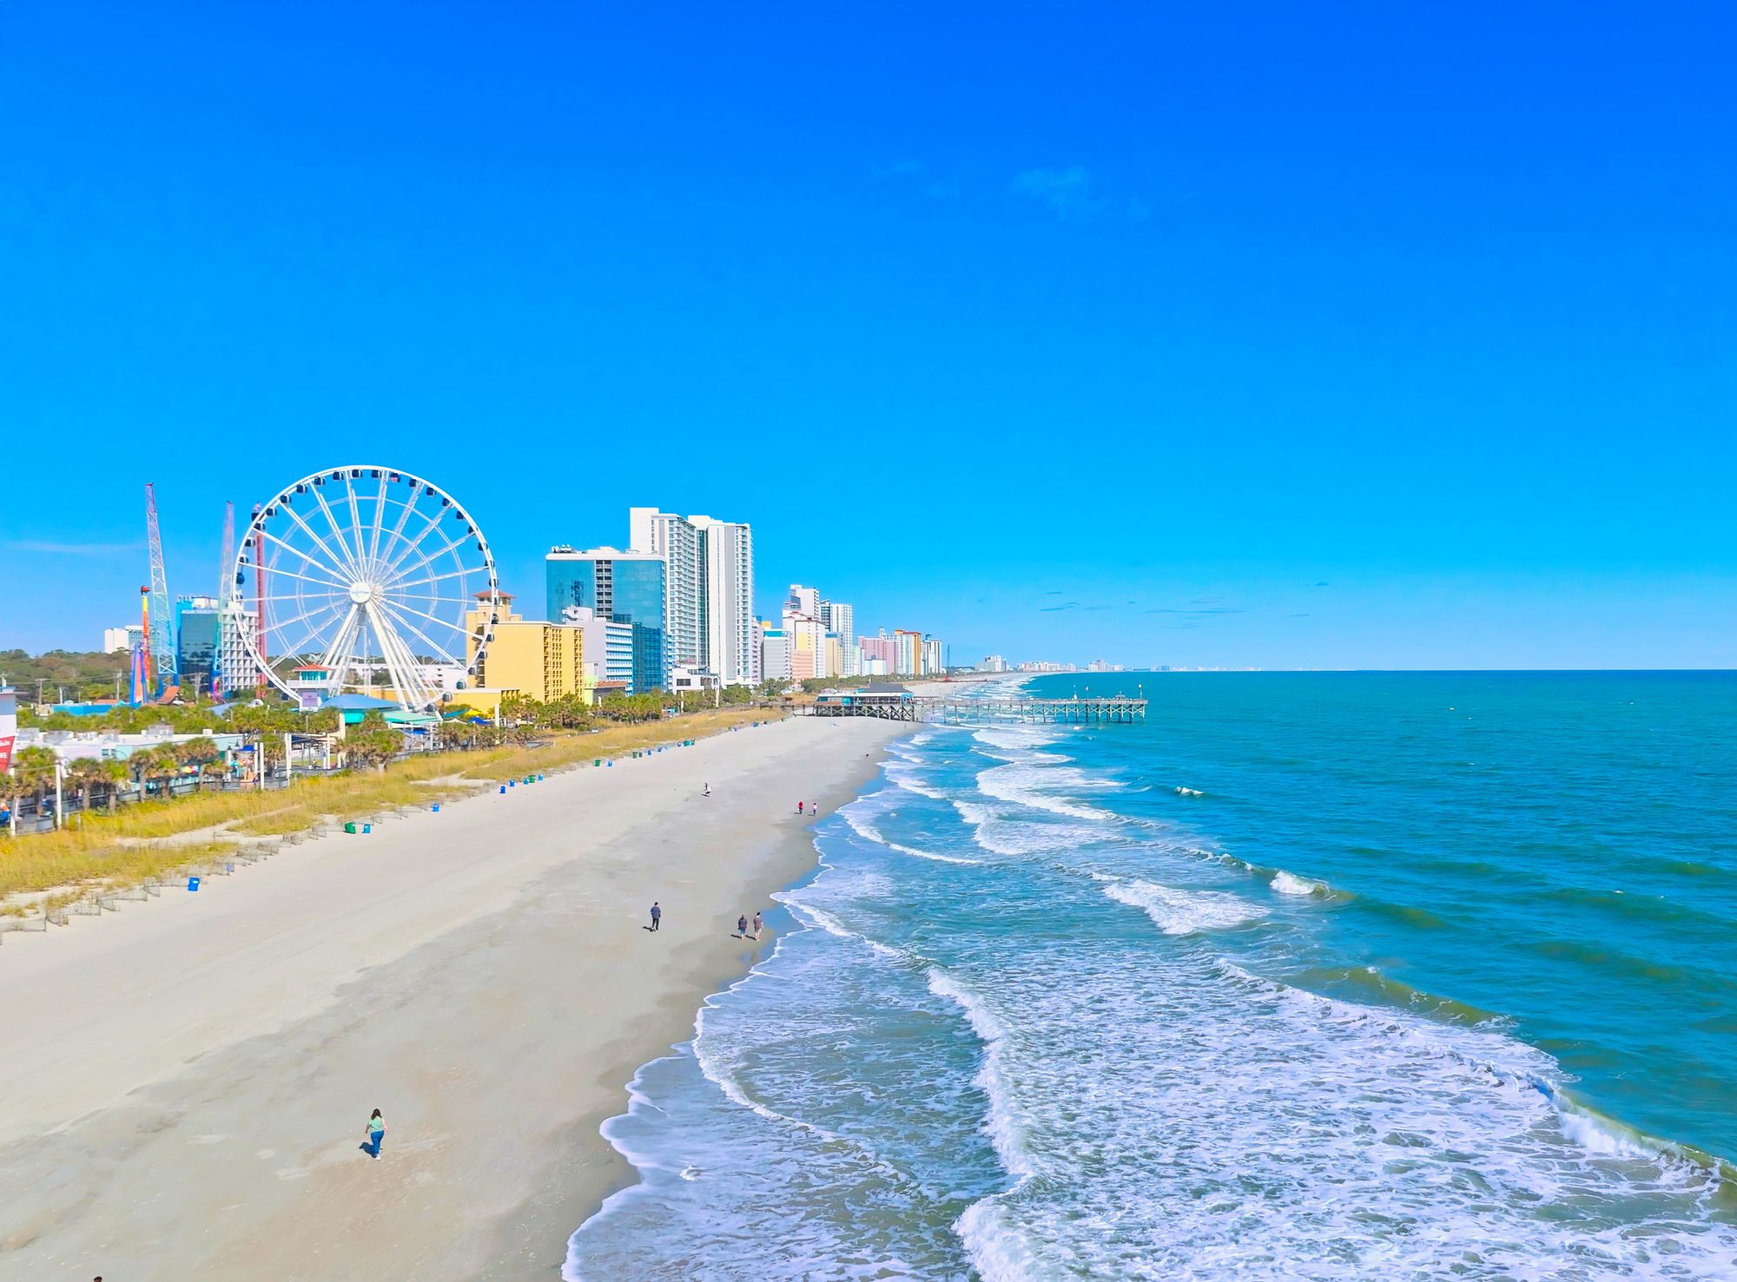
Famous places and landmarks?
3
4

Slide 5

Symbols of the State
3
5

Slide 6
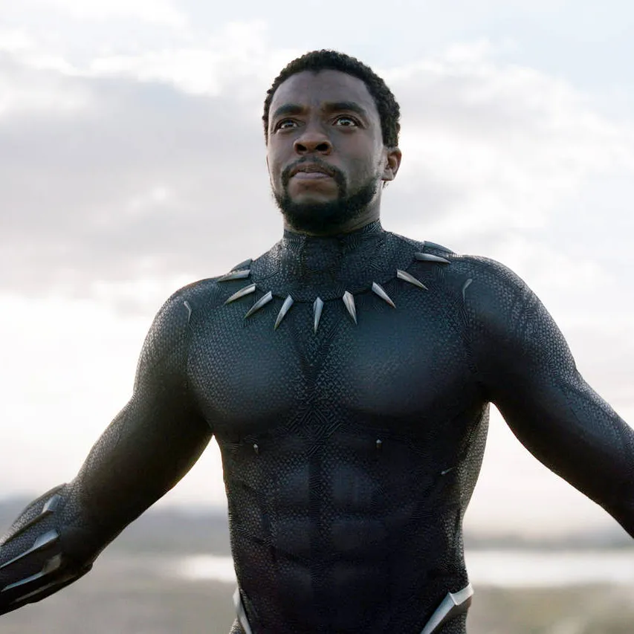
Famous People
3
6⁷

Slide 7
Facts
First state to leave the Union before Civil War.
Nickname is Palmetto
Most battles of the Revolution
₆7

Slide 8
1 Page
3 Page
4 Page
5 Page 6 Page

